Slide 1
CAPE WINELANDS
FRANSCHHOEK VALLEY

Slide 2
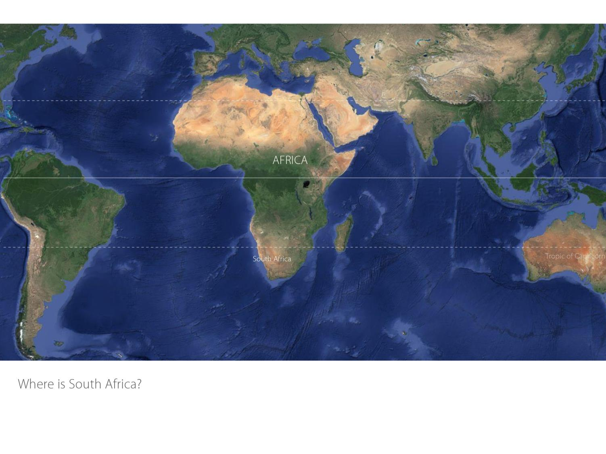

Slide 3
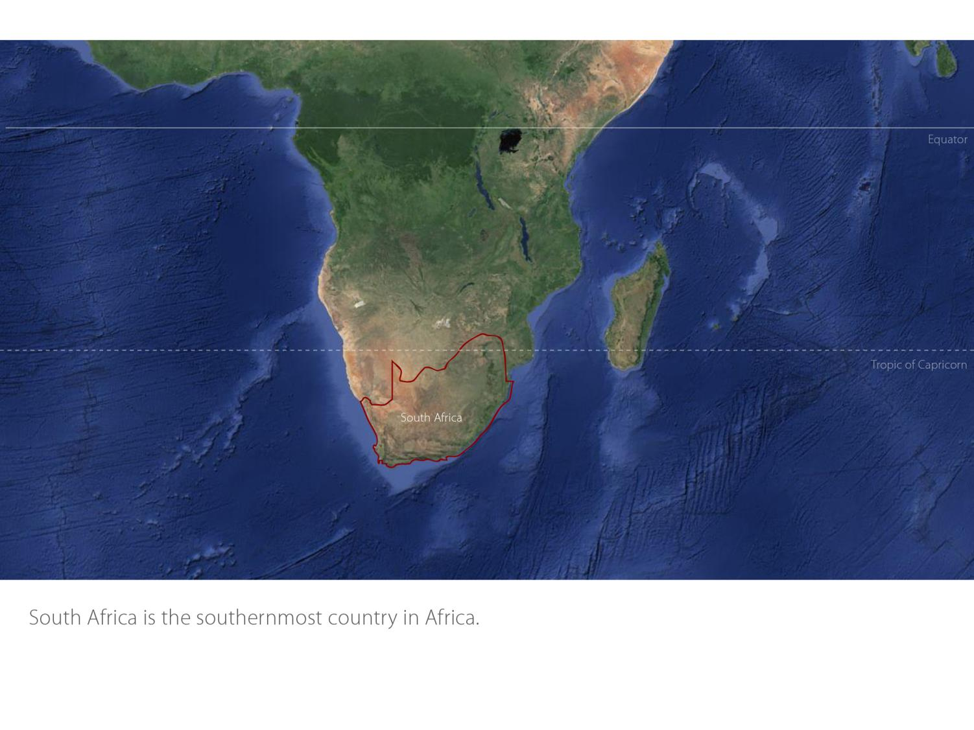

Slide 4
Our winelands are located at the very tip of South Africa.
Franschhoek Valley
Coastal

Slide 5
Franschhoek Valley
Coastal

Slide 6
Franschhoek Valley
Coastal

Slide 7
This French heritage is reflected in the names of many of the wine farms, guesthouses and restaurants.
Franschhoek Valley
Coastal

Slide 8
Franschhoek Valley
Coastal

Slide 9
Franschhoek Valley
Coastal

Slide 10
Franschhoek Valley
Coastal

Slide 11
Franschhoek Valley
Coastal

Slide 12
Franschhoek Valley
Coastal

Slide 13
Franschhoek Valley
Coastal

Slide 14
Franschhoek Valley
Coastal

Slide 15
The average rainfall is between 900–1 050 mm and the mean February temperature is 23⁰C.
Franschhoek Valley
Coastal

Slide 16
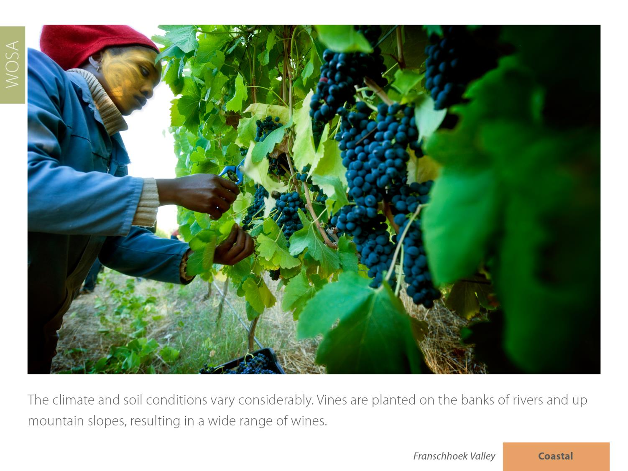
Franschhoek Valley
Coastal

Slide 17
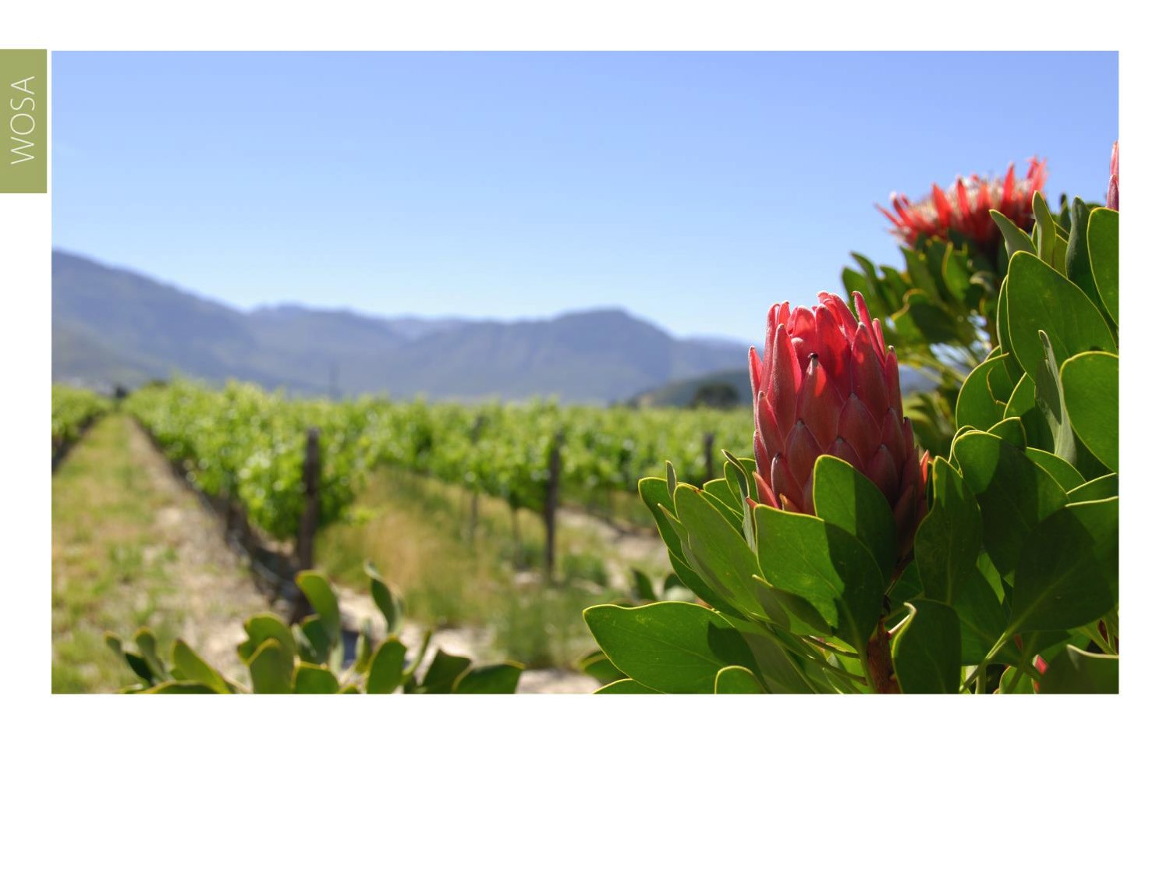
The most widely planted white-wine varieties are Chardonnay, Sauvignon Blanc and Semillon.
Franschhoek Valley
Coastal

Slide 18
Franschhoek Valley
Coastal

Slide 19
Franschhoek Valley
Coastal

Slide 20
Franschhoek Valley
Coastal

Slide 21
Franschhoek is also regarded as one of South Africa’s leading Cap Classique producing areas and has its own Cap Classique route.
Franschhoek Valley
Coastal

Slide 22
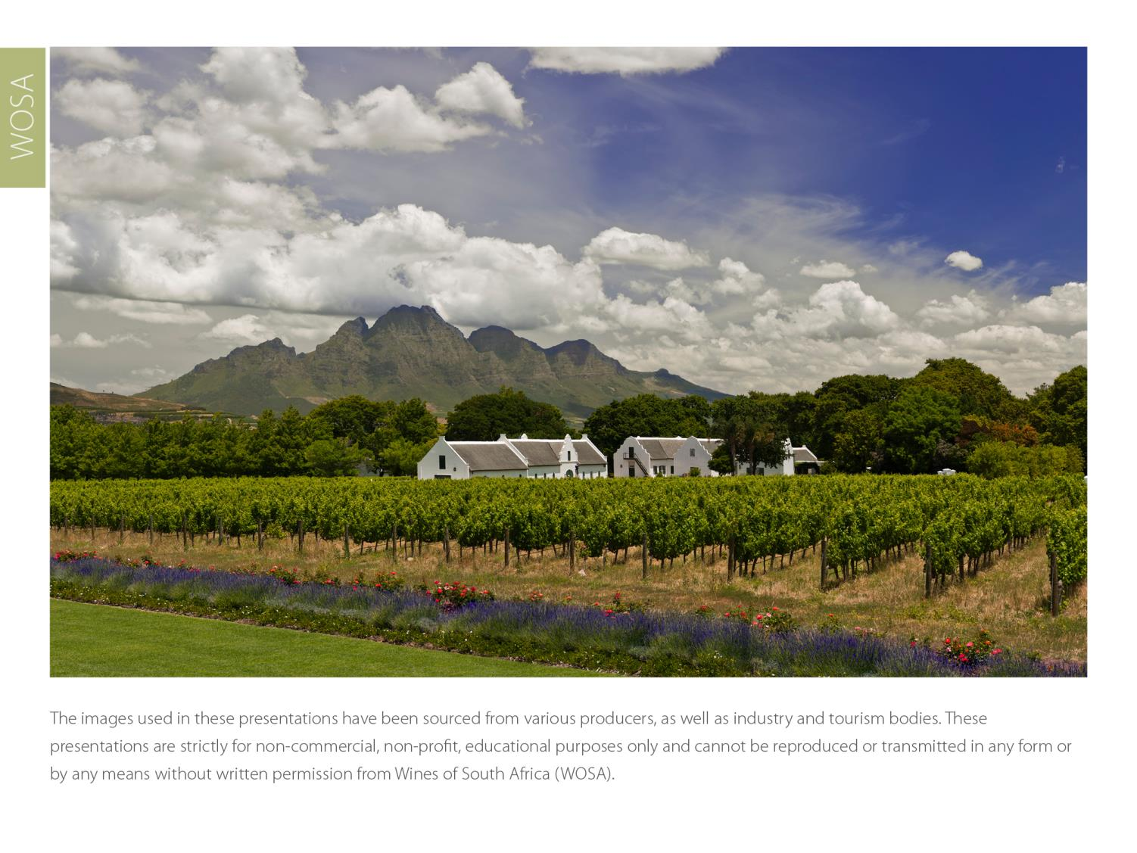
The images used in these presentations have been sourced from various producers, as well as industry and tourism bodies. These presentations are strictly for non-commercial, non-profit, educational purposes only and cannot be reproduced or transmitted in any form or by any means without written permission from Wines of South Africa (WoSA).

Slide 23
The Cape winelands, considered by many to be
the most beautiful in the world, have a network of
diverse and well-run wine routes, affording visitors
a varied and unforgettable experience.

Slide 24
THE END

